Slide 1
Rice Lake Area Association Annual Meeting
May 7, 2013

Slide 2
Annual Meeting Agenda
Call to Order Mark
Welcome
Who is the Board & What do they do?
RLAA Mission Statement George
Financials Mark
General Lake Update George
2012 Project Review
2013 Project Plans
Guest Speakers George
Shoreline Erosion (John Hiebert – DNR)
Committees George
Board Member Elections George
Drawings Scott/Joy
Adjourn George

Slide 3
Board Members
Officers
George Schneider Secretary
Rick Stulac Treasurer
Other Board Members:
Scott Roeglin •Bill Kidder
Mark Ellingson •Luke Johnson
Terms expiring in 2013
George Schneider
By-laws allow up to 15 board members – there is plenty of room for more growth

Slide 4
Rice Lake Area Association Mission Statement
As stated in the bylaws:
The Rice Lake Area Association is a non-profit organization dedicated to:
preserving, beautifying and maintaining Rice Lake, and
educating the general public in improving and preserving lake quality through their actions.

Slide 5
How RLAA Operates
RLAA is a registered non-profit pursuant to Chapter 317A of the Minnesota Non-Profit Corporation Act
Board meetings are held monthly at the Maple Grove Library from 7:00 – 9:00 PM
Agendas and minutes are posted each month on our website
RLAA members as well as any interested party may attend board meetings
Board members receive no payment for serving

Slide 6
2013 Financial Objectives
Increase participation by home owners to pay dues
For the past year (2012)
2012 revenue was roughly the same as 2011
2012 paying members were 1 less than 2011
Five year running average of $5856 per year collected
Increase city funding for Rice Lake Projects
Proceed with projects when prior Lake Improvement Project (LIP) approval for shared expense is obtained

Slide 7
RLAA Financials

Slide 8
Balance Sheet

Slide 9
Treasurer’s Report
For the fiscal year starting 5/1/2012 – 5/1/2013 the Rice Lake Area Association collected $5,611.64 in member dues. Contribution rates of $125.00 for members with water access and $60.00 for members with views continue from 2012. Our member dues were about the same collected from the prior year.
Starting the year for 2013 we have roughly $15,000.00 in the bank. We would like to continue to build our balance sheet in a positive manner. To accomplish this task we need to continue our efforts on getting new paying members. This year we are trying a raffle at the annual meeting in an attempt to generate interest and members in RLAA
Our database has about 250 street addresses! We also have over 100 e-mail addresses in our database! With an average of 45 paying members the past three years.
Our goals include increasing our membership in 2013 along with setting a target of collecting $6500.00 in overall dues.
Our projected expenses include the following for 2013
Channel Dredging $4,500.00
Annual meeting $350.00

Slide 10
General Lake Update
2012 in Review
Clean Water/Lake Shore Environment
Lake Quality Concerns
Drawdown overview
2012 Postponed Projects
2012 Completed Projects
2013 Plans
Water Quality Reminders
How Carp impact our water quality

Slide 11
2012 in Review
Objectives:
Clean Water/Lake Shore Environment
Continue performing research for long-term solutions to reduce algae and “bad” plant growth
Work towards balance of weeds vs. water clarity
Reduce algae levels
In 2012 the early, frequent rains provided a “flush” on the lake to reduce the algae growth. Again, as in 2011, the perception was that algae levels were better in 2012 than in the recent past years.
Continue creating community awareness for Rice Lake to gain public support for clean water
Rice Lake participating in Elm Creek Total Maximum Daily Load (TMDL) Project
Education
Establish consistent meaningful education for home owners on how they can help accomplish our Shared Objectives

Slide 12
Clean Water/Lakeshore Environment
2012 in Review (cont’d.)
Projects completed in 2012 to improve water quality
Conducted Aquatic Plant Survey (by FSS)
Continue to maintain a formalized Lake Management Plan and coordinate it with the Watershed TMDL Project Plan
Continue contributing lake/creek monitoring data with local agencies
Lake Shore Environment
Cut out dead trees along creek shore line
Protect shoreline in heavily-traveled fishing areas (Tristan Bay)
Monitor habitat destruction (beaver) and report to the authorities
City installed rock fill along Tristan Bay to help retain shoreline

Slide 13
Education
2012 in Review (cont’d.)
Create community awareness for Rice Lake to gain public support for clean water
Association Newsletter - periodically
Updated our Web Page/Site
Keeping it current regularly
Create periodic surveys to collect resident input
Local media (Channel 12 news and Osseo-Maple Grove Press as past examples)
E-mail significant activities to our membership

Slide 14
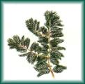
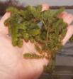
Lake Quality Concern: Algae Growth
Aquatic Plant Update
BAD WEEDS
Curlyleaf Pondweed
Currently under control, but need to keep an eye on annual growth, particularly along the shoreline
Aquatic Plant Survey in 2012 showed a slight increase in growth, but not enough of a nuisance to require treatment
Eurasian Water Milfoil
Found in only 1 of 41 stations in 2012
Not considered to be an issue in Rice Lake
GOOD WEEDS
Coontail
Increasing recently, but still lagging behind
Other Native Plants
Limited due to poor water clarity and Carp effects have been found to inhibit sprouting of new plants
Carp Enclosure project in 2010 demonstrated that many native plants can survive in our lake

Slide 15
Lake Quality Concern: Algae Growth (cont’d.)
Fish Population update:
Fish population is still out of balance
More predator fish is desirable
Undesirable fish population – very high
Bullheads
Carp
Intend on working with commercial fisherman to reduce/remove carp for positive water quality impact
Conclusion:
Algae Growth is largely due to the Carp and Bullheads over population which stir up the existing phosphorus in the lake sediments resulting in Algae Blooms. Algae shadows the sun from native plants inhibiting their growth.

Slide 16
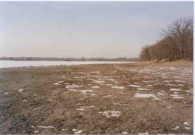
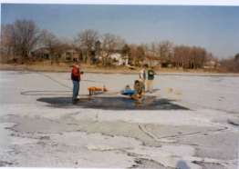
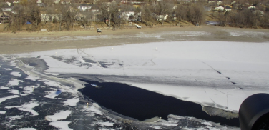
Drawdown Overview
Drawdowns are the practice of lowering the level of the water body to address specific issues, such as non-native plant growth, access to below surface (lake bottom), or reducing the surface area to attack a specific problem (i.e.: netting non-native fish).
Drawdowns have been conducted on Rice Lake in the past to specifically address unwanted Curlyleaf Pondweed (CLP) growth.
CLP dominates over all other vegetation by growing early under the ice during the winter and shading out other vegetation.
Since CLP is not common to this climate, it is been found that exposing the seedbeds to the winter elements will kill out the seeds from reproducing.
Photos from 2002-2003 drawdown
Looking southwest from Elm Creek exit
Setting out the aerator off 91st Ave
Aerial view from a helicopter after aerator opened up water (thanks to Jim Malone for this photo)

Slide 17
Drawdown Overview
Benefits of drawdowns include:
Minimum cost impact – Cost for DNR permit ($250 in 2005).
Minimum resource impact - lower the dam in the fall; raise it in the spring.
Not harmful to other aquatic plant or fish life when winter aeration is done.
Opportunity to clean up shoreline.
Negative impacts of drawdowns include:
Loss of ice coverage surface area.
Drawdowns on Rice Lake have been done 4 times in the past in 1998-99, 1999-2000, 2002-2003, 2004-2005 with the last drawdown proving to be the most effective in reducing CLP growth.

Slide 18
Drawdown Q&A
Will Rice Lake be conducting any future drawdowns?
It depends if CLP becomes a problem again. We have seen some instances of CLP growth along the shoreline increasing the past 2 years. If the 2013 season demonstrates growth up to a nuisance point, it may be necessary to have another drawdown to correct the invasive CLP impact.
What are the steps to conduct a drawdown?
Residents inform RLAA board of CLP sightings.
An accepted Aquatic Plant Survey must be conducted to justify the need.
The RLAA Board of Directors must obtain written permission from at least 75% of the homeowners who have shoreline property (creek & lake).
RLAA request permission for drawdown from the City of Maple Grove.
After City grants permission, must get DNR Permit to conduct drawdown.
City works with RLAA to manage the drawdown effort.
Do the experts recommend conducting drawdowns?
Yes, each of our resident consultants, as well as key contacts at Three Rivers Parks District all advocate a drawdown as a way of controlling non-native plant growth.
Can a drawdown be done to get rid of algae?
No, the DNR will not permit a drawdown for an algae (or any ‘Nutrient’) removal. They typically only grant a permit for vegetation removal or excavation to the lake bottom.

Slide 19
Postponed Projects – 2012
There was 1 project planned for the winter of 2012-2013 which was postponed/withdrawn:
Carp Removal Project
Objective: Remove carp from the lake to help improve water quality
How the project would be completed
Commercial fisherman obtain a DNR permit to net carp
Commercial fisherman obtain certificate of insurance releasing City of Maple Grove liability
City Parks Department grant access point at Glacier Lane cul-de-sac
RLAA clear area for staged fish removal during late fall
Commercial fisherman remove fish during winter months (ice in)
RLAA restore Glacier Lane access point with recommended plantings
Reason why the project was not completed
Unable to secure a contract with the commercial fisherman
Without contract from commercial fisherman, RLAA was reluctant to invest time and dollars into setting up and restoring a temporary access point on Maple Grove Parks property.
Next Steps
Compare notes with another near-metro area lake undergoing a similar fish removal project with the same commercial fisherman this year
Plan to require a contract from commercial fisherman before work is done
Possibly conduct the fish removal in winter of 2013-2014 if contract is secured
www.ricelakemn.com
19
Notes:
19

Slide 20
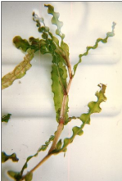
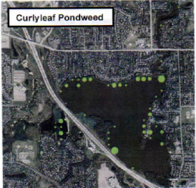
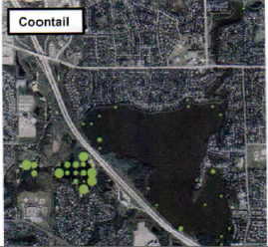
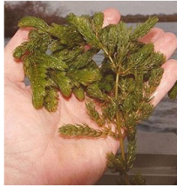
2012 Completed Projects
Aquatic Plant Survey conducted in summer 2012
RLAA Cost =$2,000.00
Objective – Monitor and compare data with previous surveys to determine if non-native weed growth is increasing. Also determine if native weed population is increasing.
Rationale for Conducting Survey – Visual reports of CLP increase in 2011 warranted to determine if treatment would be needed.
Results – Survey was conducted in early June (at CLP peak) and did indicate a slight increase in CLP growth, but not enough to warrant treatment at that time.
Other survey observations included:
As expected, CLP growth was along shoreline up to 6’ in depth.
CLP and Coontail are the most common plants in the lake.

Slide 21
2013 Plans
Continue the RLAA Newsletters (via website)
Carp Removal (Winter 2013-14)
Dredge Channel by Boat Launch (Winter 2013-14)
Encourage resident shoreline restoration projects through grant opportunities
Continue working with Elm Creek Watershed on Impaired Waters Total Maximum Daily Load (TMDL) Project Plan (in tandem with RLAA Lake Management Plan)
Storm water drainage monitoring with City Staff
Continue to increase our membership

Slide 22
Water Quality Requirements
How do Carp impact the water?
Carp are bottom feeders that eat vegetation?
Intake sediment as they search for food
Export nutrients by filtering through their gills
Dig up rooted plants
As vegetation is eliminated, water clarity is reduced by a surplus of nutrients without any absorption.
Nutrients have nowhere to go and become algae
The next slide illustrates how carp impact the water….

Slide 23
Carp effect on water quality
P, N
P, N
P, N
Notes:
23

Slide 24
Water Quality – What can you do to help?
We all know what the issues are with the lake and creek, but what can we do today to help?
Managing our shoreline
Buffer Strip to strengthen bank/filter natural nutrient flow into the water
Reduce nutrient use, especially near the water
Keep the street drains free of debris
Storm water run-off contributes a significant amount of nutrients
Pick up litter along the shoreline/in the water
Don’t use phosphorous in lawn treatment
Consider aerating your lawn on a regular basis

Slide 25
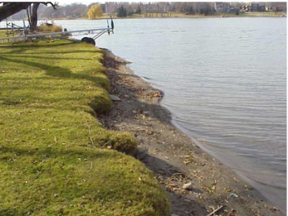
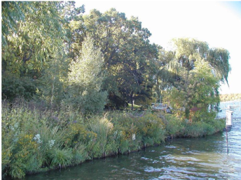
Shoreline Management
Using native vegetation to protect shoreline
Presented by John Hiebert (Lake Habitat Consultant with Minnesota DNR)
Grant monies are available for qualified projects
Shoreline restoration project on Fish Lake in Maple Grove
Before
After

Slide 26
Join the Team
Board Membership
Or
Task Teams (Committees)
Lake Management Task Team
Membership/Fundraising/Media Team
Go to RLAA website (http://ricelakemn.com) to learn more about the various projects the lake association has done in the past and what is planned for the future.
If you would like to be a part of these teams, please feel free to signup today at our meeting (Sign-up sheets are in the back of this meeting room – please sign up) or contact us by email at ricelakeassoc@comcast.net.

Slide 27
RLAA Membership
We need more members
To fund and manage projects
To liaise with other organizations (other lake associations, DNR, MG Park & Rec, etc.)
To enhance communication
To become better known in the MG community
Overall: to improve the natural beauty and quality of Rice Lake to make it a greater asset to the community.
Notes:
Maybe you are familiar with the term “it’s a numbers game”?
Basically, that means we can only do so much… and that’s really not enough to keep up with what needs to happen without killing those few that are actively engaged and giving their all to fight the good fight and wave the flag for attraction and show that the RLAA cares and wants to make a difference.
As are membership grows, so to does our ability to manage more projects & activities as well as have the critical funds necessary to engage in the vital projects at a level that can achieve a recognizable difference and thus begin the process of changing the path that Rice Lake is headed down.
We really need support in the form of increased membership including the funding these additional membership fees will bring. We really need our membership to be more active. We really need your participation to help manage the details of these important projects and to help coordination of multiple activities.
If every member only had the time & energy to accomplish just 1 thing for the RLAA; one of the most important “To Do” needs is communications… talk with your neighbors, next door, across the street, etc. make them aware of RLAA, the situation that requires everyone’s help to accomplish and make a meaningful difference in the lake’s water quality and environment value as a sustainable wildlife habitat and beautiful area to enjoy… biking, walking, jogging, watching, boating, fishing and never avoiding due to the smell of a fresh algae bloom, or a massive fish kill because of low oxygen levels in the lake such that fish can’t survive.

Slide 28
How do we increase membership and funding?
A example could be Plymouth – their fee of $5 per month on the water bill – presently not possible because MG has a General Fund
Increase membership – all three levels, including “Friends of Rice Lake”
Other Fundraising ideas:
Table at Maple Grove Days
Information box on the trail
Occasional table giving out info on a Sunday afternoon
Grants?
Notes:
Ask audience for feedback on these
Engage attendees for their ideas & comments

Slide 29
Board Member Elections
2013 Terms Expiring
George Schneider
Volunteered to serve another 3-year term ending 2016 as Secretary
Accept nominations for new board members
3-year term
Open to any RLAA member
Do we have any volunteers?

Slide 30
Drawings!
Random Drawing for:
Gift Certificate #1
Gift Certificate #2
Gift Certificate #3
Gift Certificate #4

Slide 31
THANK YOU Comments? Questions? Volunteer!

