Slide 1
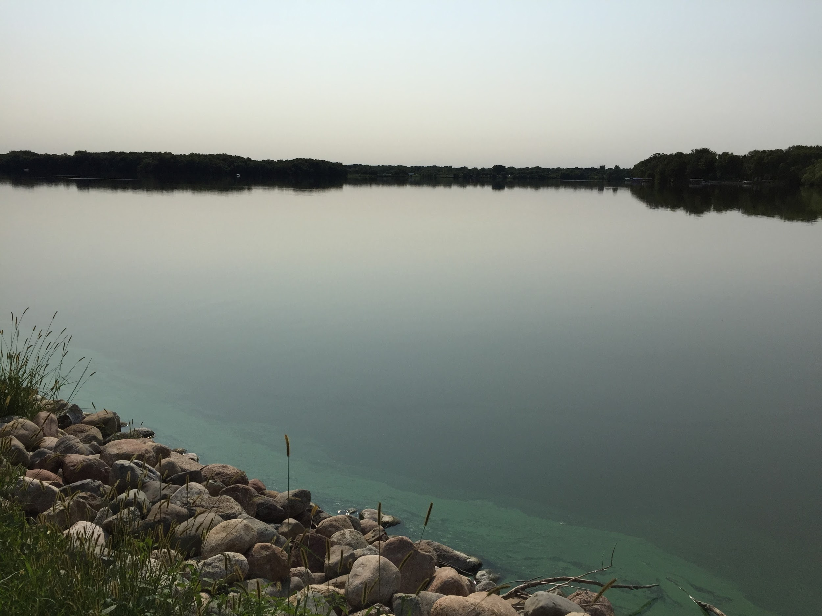
Rice Lake Area Association Annual Meeting
May 4, 2021

Slide 2
Zoom Meeting Ground Rules
All attendees will be on mute (except for the presenter)
Please hold all questions until the presenter asks for any between different sections of the agenda
If you have a question, please turn off the ‘Mute’ button to be heard
This meeting will be recorded.

Slide 3
Annual Meeting Agenda
Call to Order
Board Member introductions
Financials
Lake Update
2020 Completed Projects
2021 Planned/In Process Projects
Water Quality Review
Website and Facebook
Board Member Election
4 members positions expire this year
1 new member has joined the board
Open Forum
Adjourn

Slide 4
Board Members
Officers
George Schneider Secretary (Term expires in 2022)
Mike Thiede Treasurer (Term 2024)
Other Board Members:
Scott Roeglin (Term 2024)
Mark Ellingson (Term 2023)
Luke Johnson (Term 2023)
Rick Stulac (Term 2024)
Jeremy Coenen (Term 2024)
Curt Putland (Term 2023)
Hente Braam (Term 2022)
Welcome to our newest board member!
Nicholas Mannel (Term 2024)
By-laws allow up to 15 board members
Give Back to The Community
Have a Voice in Helping Decide Rice Lake’s Future
Board Members are Volunteers Elected by the RLAA Board

Slide 5
Rice Lake Area Association Mission Statement
As stated in the bylaws:
The Rice Lake Area Association is a non-profit organization dedicated to:
preserving, beautifying and maintaining Rice Lake, and
educating the general public in improving and preserving lake quality through their actions.

Slide 6
2021 Financial Objectives
Increase participation by homeowners to pay dues
For the past year (2020)
2020 revenue was up ~44% vs. 2019 ($8,330 vs $5,795)
2020 had 14 more paying member vs. prior year (66 to 52)
66 paying members is believed to be a RLAA record high!
Five year running average of $6,126 per year collected
Increase city funding for Rice Lake Projects
Proceed with projects under the Lake Improvement Project (LIP) program from the City of Maple Grove
2020 GoFundMe raised $8,194
Funds are being held in RLAA bank account and will be used to pay for completion of the dredging project.

Slide 7
Notes:
7

Slide 9
Treasurer’s Report
Fiscal year ending: May 1 2021
For the fiscal year 5/1/2020 – 5/1/2021 the Rice Lake Area Association collected $8,330 in member dues.
Contribution rates of $125.00 for members with water access and $60.00 for members with views. The dues will drop to $100 for the next year (2021-2022)
This year we had many large projects which cut into our savings
Starting the year for 2021 we have roughly $21,000.00 in the bank, down from $21,700 this time last year.
Contact Database
Our database has about 250 street addresses!
We also have over 100 e-mail addresses in our database!
Members
Last year we had 66 paying members; this is 14 more than the year before and a record high!
2021 Goals
Our goals include increasing our membership in 2021 to help cover some large project costs

Slide 10
Lake Update
2020-2021 Update
Rice Lake surface water regulations
http://www.maplegrovemn.gov/about/lakes-and-water-quality/rice-lake/
2020 Year in Review
2020 Completed Projects
2021 Continuing Projects
2021 Planned Projects

Slide 12
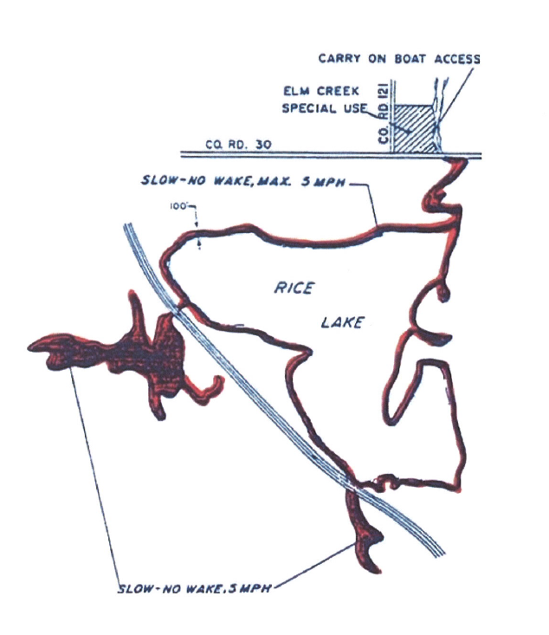
No Wake in any part of Elm Creek or the backwater connection to Fish Lake!
West of I-94 to the bridge (A on map)
Connection to Fish Lake (B on map)
Elm Creek north of lake (C on map)
C
A
B

Slide 13
2020 Year in Review
Timeline:
No drawdown was conducted in the past 6 years (last was in 2014-2015)
Request for 2020-21 was denied due to existence of rare Blanding’s Turtle within the watershed
Future drawdown requests would need to begin no later than October 15th
Winter Aeration was done the past 4 winters (to help sustain previous 2 fish stockings)
Longer ice and snow cover reduces dissolved oxygen levels, which impacts fish
Water levels were above normal for most of the 2020 open water season, due to more frequent rainfalls which helped “flush” out the lake. Was lower going into the fall.
Curlyleaf Pondweed (CLP) was observed more frequently again in 2020. Eurasian Watermilfoil (EWM) has also increased significantly in the past couple of years. An AIS Survey conducted in June confirmed this.
Water quality during the outdoor boating season was observed to be better than recent years without any major algae blooms
Fishing seemed to be a little better as more game fish were caught (and released) compared to the last several years.
Cormorant presence was less than in the recent past, getting more dense during late the summer.
Winter 2020-2021 was relatively mild
Spring 2021 water level has been about average (so far)

Slide 14
Completed Projects – 2019-20
Carp Assessment Project with Fish Lake
Objective: To track and remove carp in either Winter or open water season
Action Taken:
Winter (2019-2020) – Attempted to net on Rice Lake, but carp scattered
Winter (2020-2021) – Attempted to net on Fish Lake, but nets got hung up
Next Steps
Phase II – Continue tracking and plan to remove carp in 2021-2022.
Conduct AIS Plant Survey to justify drawdown request
Survey completed by FSS in June 2020
Replace Winter Aeration system
Objective: To replace old above water system with new underwater diffuser system
Action Taken:
Purchased/installed a new system in Summer 2019
Ran the new system in both 2019-2020 and 2020-2021 successfully
Next Steps
Does anyone have a buyer for our old aeration system?
Notes:
14

Slide 15
Continuing Projects – 2021
Channel Dredging Project
Objective: To deepen the channel entering the Boat Ramp Bay, which has never been dredged out before. Boaters sometimes hit bottom in this shallow bay entry.
How the project would be completed:
Approval of 100% of adjacent homeowners for the DNR permit (completed).
RLAA has secured a dredging contractor (completed).
GoFundMe project raised enough funds to cover cost (completed)
Reason why the project was not completed in 2020:
Contractor prefers to do during a drawdown, which was not approved by DNR
Tried to work on project late this winter, but dropped a Bobcat through the ice
Next Steps
Pursue a drawdown for the winter of 2021-2022
Contractor would work on the project after water is down, but before the ground freezes.
Notes:
15

Slide 16
Continuing Projects (cont.)
Carp Removal Project with Fish Lake
Objective: To track and remove carp in either Winter or open water season
Action Taken:
Winter (2019-2020) – Attempted to net on Rice Lake, but carp scattered
Winter (2020-2021) – Attempted to net on Fish Lake, but nets got hung up
Next Steps
Phase II – Continue tracking and plan to remove carp in 2021-2022.
Boat Ramp Enhancements
Objective: To secure and improve the private boat ramp so only RLAA dues paying members have access
Reason: Too many non-member have used/tried to use the ramp in the past
Action Taken:
Fall (2020) – Ramp widened by 4 feet with pavers; posts installed
Winter (2020-21) – Informed RLAA members of these changes
Next Steps
Spring (2021) – Incorporate keypad with lock between posts
Temporary code 1234 to be used for all members through June 15
Notes:
16

Slide 17
2021 Project Plans
Continue to update the RLAA website
Dredge Channel by Boat Launch (Fall 2021)
Encourage individual shoreline restoration projects subsidized by grants from Hennepin County
Hennepin County “Good Steward” Grant program https://www.hennepin.us/residents/environment/natural-resources-funding#natural-resources-grants
Continue working with Elm Creek Watershed on TMDL Project
Continue to increase our membership
Continue joint effort with Fish Lake to track/remove carp (2021-22)

Slide 18
Hennepin County Good Steward program
Description
Hennepin County offers a “Good Steward” program to private residents to improve their properties with various water quality projects. Grants can be obtained directly from the county via a link on the RLAA website:
https://www.hennepin.us/residents/environment/natural-resources-funding#natural-resources-grants
Examples of such projects include:
Native Shoreline Restoration
Bioengineered Shoreline (not riprap)
Bioengineered Slopes
Rain Gardens
Native Buffer

Slide 19
Water Quality – What can you do to help?
We all know what the issues are with the lake and creek, but what can we do today to help?
Managing our shoreline
Buffer Strip to strengthen bank/filter natural nutrient flow into the water
Reduce nutrient use, especially near the water
Keep the street drains free of debris
Storm water run-off contributes a significant amount of nutrients
Pick up litter along the shoreline/in the water
Don’t use phosphorous in lawn treatment
Some commercial applicators still use phosphorous in their treatments. Make sure you ask them before you commit!
Consider aerating your lawn on a regular basis

Slide 20
RLAA Website
Visit our website (http://ricelakemn.com) to learn more about the lake and association, as well as projects the lake association has done in the past and what is planned for the future.

Slide 21
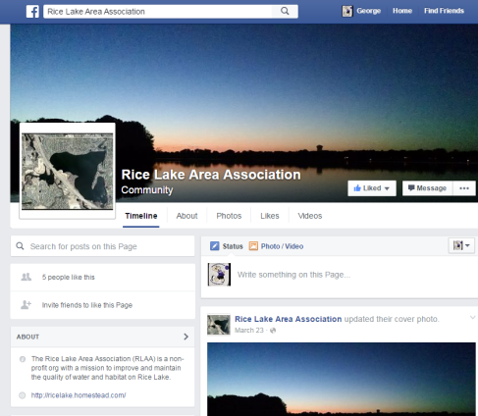
Rice Lake is on Facebook!
You can also find us on Facebook under the Facebook Groups https://www.facebook.com/RiceLakeMG/

Slide 22
Board Member Elections
2021 Terms Expiring
Scott Roeglin
Jeremy Coenen
Mike Thiede
Rick Stulac
All volunteered to serve another 3-year term ending in 2024
Welcome New Board Member
Nicholas Mannel
Accepting nominations for new board members
3-year term
Open to any RLAA member

Slide 23
Open Forum
Feel free to bring up any items not already covered tonight
If we do not have an answer for you tonight, we will get back to you after this meeting

Slide 24
THANK YOU Comments? Questions? Volunteer!

