Slide 1
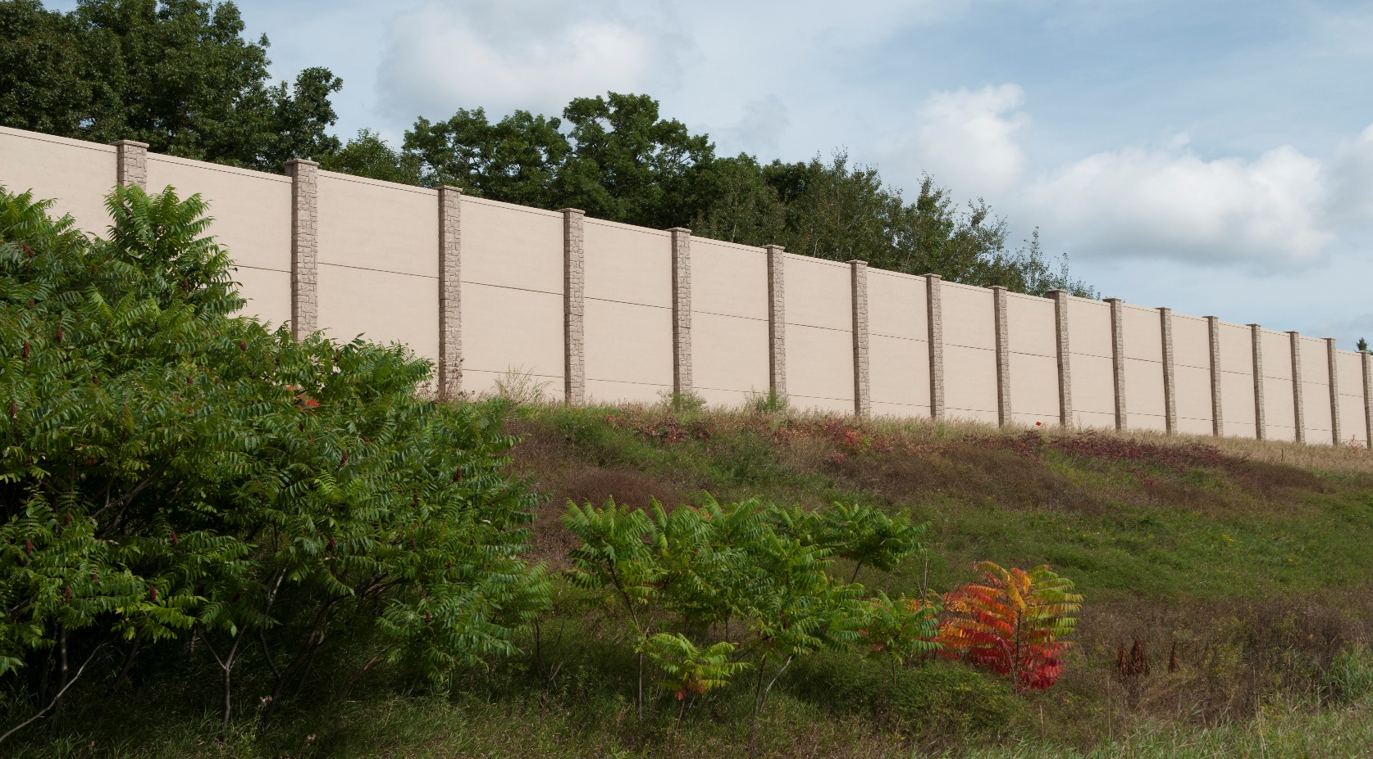
I-94 Maple Grove to Rogers
Community Noise Engagement Meeting #1
Natalie Ries| MnDOT Metro Noise/Air Supervisor
July 31, 2018, 6:00 PM

Slide 2
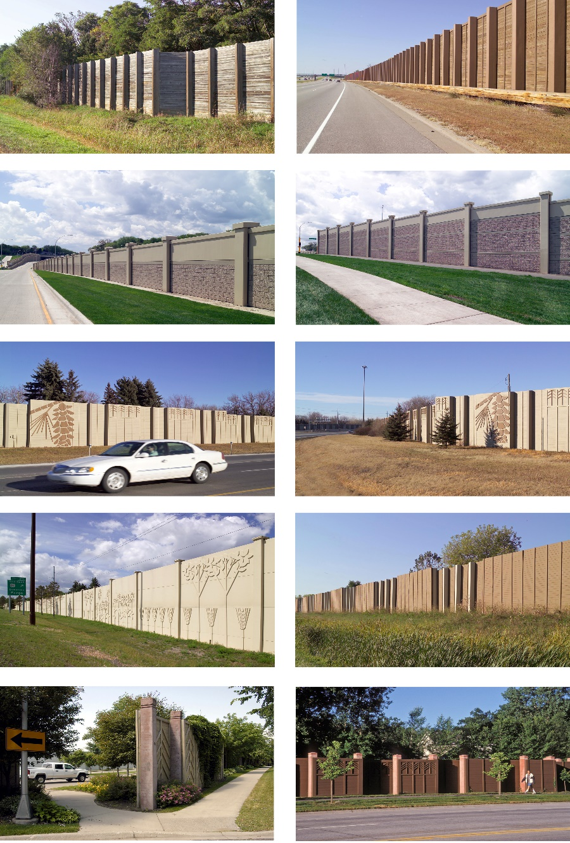
Agenda
Community Noise Engagement
Objectives
I-94 Project Noise Overview
Traffic Noise Basics
Video
Traffic Noise Analysis
MnDOT Noise Requirements
Noise Barrier Voting
Next Steps

Slide 3
Community Noise Engagement Objectives
Inform residents when MnDOT is conducting a noise analysis in their community
Provide greater understanding of MnDOT’s noise analysis process
Inform residents about the noise barrier voting process
Seek membership for smaller CNE Group
  Provide two-way communication between community and the MnDOT project team
  Review noise analysis methodology and results
  Communicate noise analysis and project information to your neighborhood
  Help with voter turnout for noise barrier voting
MnDOT's Noise Analysis Webpage

Slide 4
I-94 Maple Grove to Rogers – Noise Analysis
Why is MnDOT doing a noise analysis for this project?
  23 CFR 772 and Minnesota Rules Chapter 7030
  Federally-funded Type I project:
    (5) The addition of an auxiliary lane, except for when the auxiliary lane is a turn lane
    (6) The addition or relocation of interchange lanes or ramps added to a quadrant to complete an existing partial interchange
  Limits of Noise Analysis
    If the project is determined to be a Type I project, then the entire project area is as defined in the environmental document is a Type I project
MnDOT's Noise Analysis Webpage

Slide 5
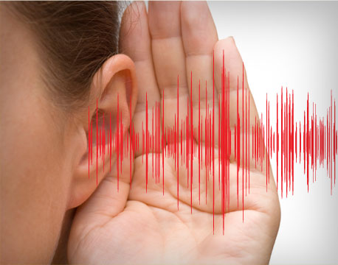
Traffic Noise Basics

Slide 6
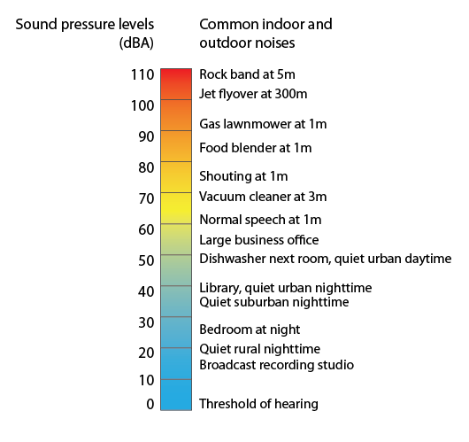
Terminology
Sound: A vibration that causes pressure variations in air and water. Noise is unwanted sound.
Decibel (dB): Sound pressure level is used to measure the intensity of sounds.
A-weighted decibel (dBA): Gives a scale for noise levels as perceived by the human ear.
Leq(h): Average sound pressure level over one hour.
Source: Minnesota Pollution Control Agency
MnDOT's Noise Analysis Webpage

Slide 7


Log Scale
A doubling of energy, or doubling of identical sources, results in an increase of 3 dBA
2000 vehicles per hour
4000 vehicles per hour
is 3dB louder
MnDOT's Noise Analysis Webpage

Slide 8
Noise Level Changes
1 dBA (increase or decrease) = not noticeable
3 dBA (increase or decrease) = threshold of perception
5 dBA (increase or decrease) = clearly noticeable
10 dBA (increase or decrease) =
perceived as twice as loud (or half as loud)
Source: Minnesota Pollution Control Agency. 2008. A Guide to Noise Control in Minnesota
MnDOT's Noise Analysis Webpage

Slide 9
Distance Attenuation
Beyond approximately 50 feet from a sound source such as a highway, doubling of distance will yield:
  Sound level decrease by 3 dBA over hard ground (pavement, water)
    50 feet = 70 dBA
    100 feet = 67 dBA
    200 feet = 64 dBA
  Sound level decrease by 4.5 dBA over soft ground (vegetation)
    50 feet = 70 dBA
    100 feet = 65.5 dBA
    200 feet = 61.0 dBA
Source: Minnesota Pollution Control Agency. 2008. A Guide to Noise Control in Minnesota
MnDOT's Noise Analysis Webpage

Slide 10
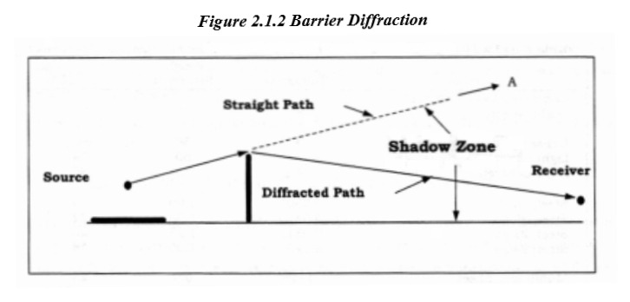
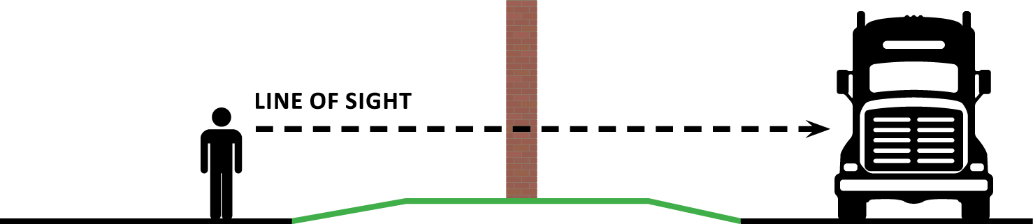
How do Noise Barriers Work?
Block the direct path of sound waves from the highway (source) to adjacent residences (receptor)
Tall and long enough to block line of sight between the highway and residences
Will not block or eliminate all noise
Noise barrier effectiveness considerations:
  Distance between the source and the receptors. Noise barriers are most effective for the first and second rows of residents (~300-400 feet from barrier)
  Topography
  Intervening features such as buildings or
  earthen berms
Source: Federal Highway Administration
MnDOT's Noise Analysis Webpage

Slide 11
Video
MnDOT - 2015 Noise Wall Master Video

Slide 12
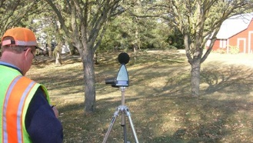
Traffic Noise Analysis I
Noise Monitoring
  Document existing noise levels in the field at representative sites
  Noise model validation (+/- 3 dBA)

Slide 13
Traffic Noise Analysis II
Noise Level Modeling
  Characteristics of roadway (horizontal and vertical alignments)
  Receptor sites (represent residences, businesses, trails, parks, etc.)
    Outdoor place where frequent human use occurs
    Typically within 500 feet of the project corridor
    Noise Abatement Criteria is defined by land use
  Loudest Hour
    Traffic volumes and speeds
    Vehicle types (cars, medium trucks, heavy trucks, buses, motorcycles)
  Topography (ground lines, buildings, existing noise barriers or berms)
  Existing conditions, Future No-Build, and Build conditions (generally a 20-year traffic projection)
  Not modeled:
    Weather conditions
    Surface type
MnDOT's Noise Analysis Webpage

Slide 14
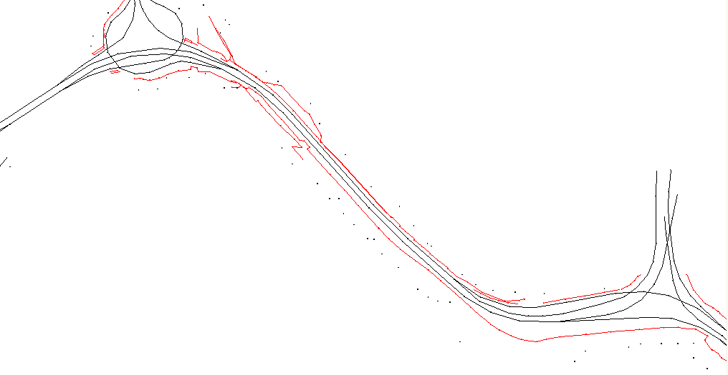
Traffic Noise Analysis III
Source: TNM 2.5
MnDOT's Noise Analysis Webpage

Slide 15
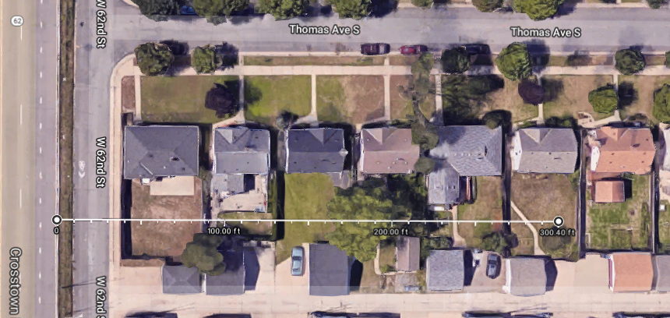
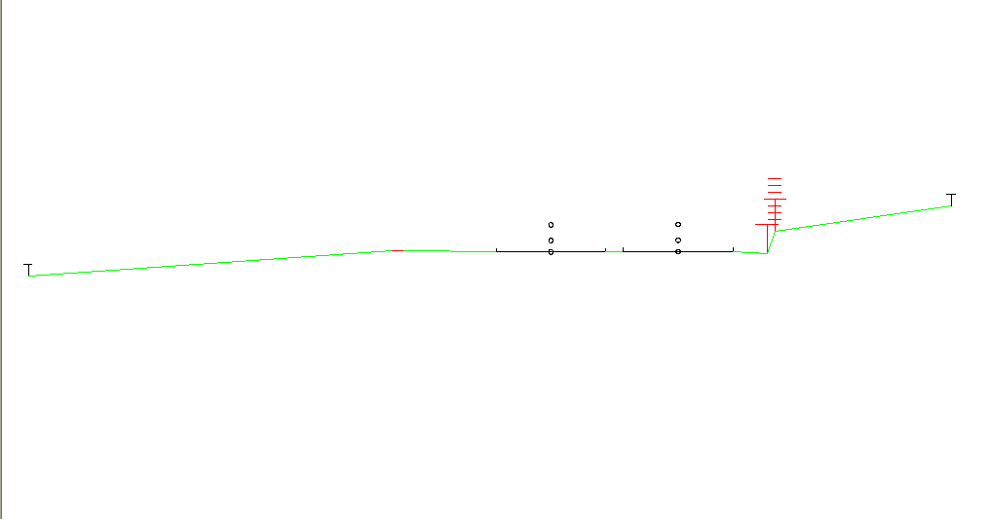
Traffic Noise Analysis IV
Noise Mitigation Modeling
  Consideration of noise mitigation measures for areas where noise level impacts are predicted (e.g., noise barriers)
  Model variety of lengths, heights, and locations as necessary
  Determine noise insertion loss for each barrier (i.e., noise level without barrier
  vs. noise level with barrier)
  Decisions about where noise barriers are proposed are based on feasibility and reasonableness
MnDOT's Noise Analysis Webpage

Slide 16
MnDOT Noise Requirements I
Provides guidance for how noise analyses should be completed for MnDOT projects and other Type I projects in Minnesota
Developed in conjunction with MPCA and FHWA
Updated in July 2017
Defines MnDOT’s thresholds for
feasibility and reasonableness of
noise barriers

Slide 17
MnDOT Noise Requirements II
How does MnDOT determine where noise barriers will be constructed?
  Is loud enough? (Impact, Noise Abatement Criteria)
  Can a barrier be engineered at this location that effectively blocks noise? (Feasibility)
  Does a barrier provide noticeable levels of noise reduction? (Reasonableness – Noise Reduction Design Goal)
  Does the barrier provide noticeable levels of noise reduction for enough people to justify the cost? (Reasonableness – Cost Effectiveness)
  Do people want a noise barrier? (Noise Barrier Voting Process)
MnDOT's Noise Analysis Webpage

Slide 18
Noise Abatement Criteria
Traffic Noise Impact
  Noise levels are approaching or exceeding the NAC.
    Approaching is defined as within 1 dBA.
    Typically looking at future Build noise levels
    E.g., 66 dBA (Leq) for residential land uses
  Substantial noise increase
    5 dBA or more increase between existing noise level and future Build noise level
MnDOT's Noise Analysis Webpage

Slide 19
Feasibility
Acoustic feasibility - 5 dBA reduction at impacted receptors for them to be considered benefited)
Engineering feasibility is determined by physical and/or engineering constraints (i.e., could a noise barrier feasibly be constructed on the site?)
20 foot maximum height for MnDOT noise barriers
Considerations:
  Does MnDOT have the required right of way to construct the barrier?
  Safety concerns such as sight distances and clear zones
  Buried utilities or utility relocation needs
  Impacts to drainage or drainage features within right of way
  Soil types or wetland areas
MnDOT's Noise Analysis Webpage

Slide 20
Reasonableness – Noise Reduction Design Goal
Noise Reduction Design Goal - A noise reduction of at least 7 dBA must be achieved at a minimum of one benefited receptor for each proposed noise abatement measure
MnDOT's Noise Analysis Webpage

Slide 21
Reasonableness – Cost Effectiveness
Cost effectiveness:
  Does the barrier meet a cost effectiveness value of $78,500 per benefited receptor
  Benefited Receptor = receptor that experiences a 5 dBA or greater level of noise reduction from the barrier
  Based on barrier costs of $36/sq ft (~$3.8 million per mile)
  Consideration of other costs such as guard rail, rub rail, utility relocation, etc. shall be added to the baseline unit costs
MnDOT's Noise Analysis Webpage

Slide 22
Reasonableness – Noise Barrier Voting
If a noise barrier meets the MnDOT the feasibility and reasonableness criteria, then the viewpoints of the benefited residents and owners need to be solicited through a voting process.
  30 day voting period, mailers and public meeting
  Points system with weighted vote (1st row vs. 2nd row; owner vs. resident)
  Aim to achieve 50% response rate based on points
  Majority of points received determines outcome of barrier
MnDOT's Noise Analysis Webpage

Slide 23
Next Steps
Volunteers for Community Noise Engagement Group?
CNE Group Meeting #2 – August/September 2018
CNE Group Meeting #3 – October 2018
Noise Barrier Voting – December 2018 (30 days)
Noise Barrier Voting Public Meeting – December 2018
Noise Barrier Construction – with project in 2020
MnDOT's Noise Analysis Webpage

Slide 24
Thank you!
Natalie Ries
Natalie.Ries@state.mn.us
651-234-7681

